Slide 1

Full-Duplex UART Protocol
Hardware Microarchitecture
Complete RTL design with 4 TX Submodules, 6 RX Submodules, isolated Datapath/Control-Path separation, and strict black-box verification in ModelSim.

Slide 2


System Hierarchy: 4 TX & 6 RX Modules
Transmitter Subsystem (4 Modules)
Receiver Subsystem (6 Modules)
1. p_calc (Parity Calculator): Pure combinational XOR tree calculating even/odd parity.
1. neg_edgedetector: Captures line drop from HIGH to LOW with handshake lock.
2. serializer (PISO Shift Reg): Synchronous register loading 8-bit parallel byte and shifting LSB-first.
2. start_checker: Filters false glitches and validates steady 0 during start bit.
3. fsm_tx (TX Controller): State sequencer coordinating cycles and asserting o_tx_busy.
3. deserializer (SIPO): Gathers serial bits sequentially into an 8-bit output word.
4. mux (Output Selector): 4-to-1 dynamic multiplexer driving start bit, payload, parity, or stop bit onto o_tx.
4. p_checker: Recomputes parity and flags active-high o_parity_err on mismatch.
5. stop_checker: Confirms line returns to 1, raising o_framing_err if low.
6. fsm_rx: Master supervisor sequencing reception and driving o_rx_valid.

Slide 3

Transmitter (TX) Architecture
In-Depth Breakdown of the 4 Transmit Pipeline Submodules

Slide 4

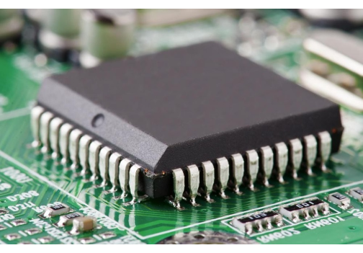
TX Datapath: Parity & Serializer
p_calc (Parity Calculator): A pure combinational block executing a parallel XOR tree across the 8-bit input bus (i_data[7:0]). Dynamically calculates odd/even parity via the formula Parity = ^i_data ^ i_par_odd without adding register latency.
serializer (PISO Register): Synchronous sequential register operating on the rising edge of i_clk with asynchronous active-low reset. When signaled by FSM, it latches the entire 8-bit parallel word and delivers it bit-by-bit (LSB first) across 8 consecutive clock pulses.
Clock-Domain Determinism: Zero race hazards achieved by keeping arithmetic XOR trees in combinational logic and shift registers strictly synchronous.

Slide 5


TX Control: FSM & Multiplexer
fsm_tx (TX State Machine)
mux (4-to-1 TX Selector)
Master TX Sequence: Coordinates transitions across IDLE → START → DATA (8 cycles) → PARITY → STOP states.
Hardware Serialization Bridge: Directs the proper bit source to the physical serial line o_tx.
Buffer Overwrite Protection: Asserts active-high o_tx_busy immediately upon transfer initiation, preventing upstream processors from corrupting internal registers.
Input Multiplexing Map:
• 2'b00 → Start Bit: Constant logic 0.
Mux Select Control: Generates cycle-accurate 2-bit select lines steering the serializer, start bit, parity bit, and stop bit.
• 2'b01 → Serial Data: Output from serializer.
• 2'b10 → Parity Bit: Output from p_calc.
• 2'b11 → Stop Bit: Constant logic 1 (IDLE level).

Slide 6
Receiver (RX) Architecture
In-Depth Breakdown of the 6 Reception, Filtering, and Check Submodules

Slide 7


RX Detection & Glitch Filtering
neg_edgedetector (Falling-Edge Strobe)
start_checker (Glitch Rejection)
Quiescent Line Monitor: Continuously monitors the high idle bus for a transition to logic 0.
Anti-Noise Validator: Verifies that the detected drop is an authentic start bit and not an inductive line spike or transient glitch.
Single-Cycle Trigger: Fires a clean, synchronous 1-cycle alert strobe on the falling edge to awaken the receiver FSM.
Windowed Inspection: Confirms the serial line remains firmly held at logic 0 throughout the allocated start-bit interval.
Handshake Protection: Employs an internal lock-out latch that ignores subsequent falling edges until the current frame completes and the FSM issues a clear acknowledgment.
Abort Safeguard: Directs the FSM back to IDLE without corrupting buffers if the line bounces back to 1 prematurely.

Slide 8




RX Deserializer, Parity & Stop Checkers
deserializer (SIPO)
p_checker (Parity Verify)
stop_checker (Framing)
Synchronous Serial-In Parallel-Out shift register. Samples incoming serial pulses clock-by-clock, shifting rightwards to assemble the full 8-bit word into a stable register.
Reconstructs expected parity over the deserialized byte and matches it against the received serial parity bit. Directly raises active-high o_parity_err = 1 upon discrepancy.
Inspects the bus during the designated stop-bit cycle. If the line is detected at logic 0 instead of 1, asserts o_framing_err = 1 to capture clock drift and framing anomalies.

Slide 9

Receiver Controller: fsm_rx
Orchestrator Role: Master supervisory FSM integrating and synchronizing all 5 companion RX submodules in a deterministic sequence.
State Trajectory: IDLE → START_CHECK → DATA_ACQUIRE (8 clock cycles) → PARITY_CHECK → STOP_CHECK.
Handshake Clear: Releases neg_edgedetector handshake lock after line closure, arming it for the subsequent packet.
Valid Data Strobe: Emits a single-clock pulse on o_rx_valid along with valid 8-bit data when all parity and framing checks pass without error.

Slide 10
Architectural Submodule Matrix
Domain | Submodule Name | Logic Type | Core Function / Responsibility
TX (4) | p_calc | Combinational | Calculates dynamic XOR parity (even/odd)
serializer | Sequential (PISO) | Latches 8-bit parallel byte & shifts LSB-first
fsm_tx | Sequential FSM | Controls state lifecycle & asserts o_tx_busy
mux | Combinational | 4-to-1 selector steering Start/Data/Parity/Stop to o_tx
RX (6) | neg_edgedetector | Sequential | Detects 1→0 edge with latching handshake
start_checker | Combinational | Rejects transient noise glitches during start bit
deserializer | Sequential (SIPO) | Assembles 8 incoming serial bits into parallel byte
p_checker | Combinational | Compares received parity against calculated; flags error
stop_checker | Combinational | Validates stop bit is logic 1; flags framing error
fsm_rx | Sequential FSM | Supervises RX path, validates checks & asserts o_rx_valid

Slide 11
Strict Black-Box Verification Strategy
Zero Internal Probing: Testbenches interact strictly with top-level port interfaces, mirroring physical silicon verification standards.
Deterministic Timing: Precision 100 MHz clock generation with calibrated setup and hold margins to prevent delta-cycle race hazards.
Fault Injection Testing: Directed test cases with inverted parity bits and truncated stop lines to validate immediate error flag triggers.
Asynchronous Reset Interruption: Triggering reset mid-transaction to verify instantaneous recovery without uninitialized states ('bx).

Slide 12
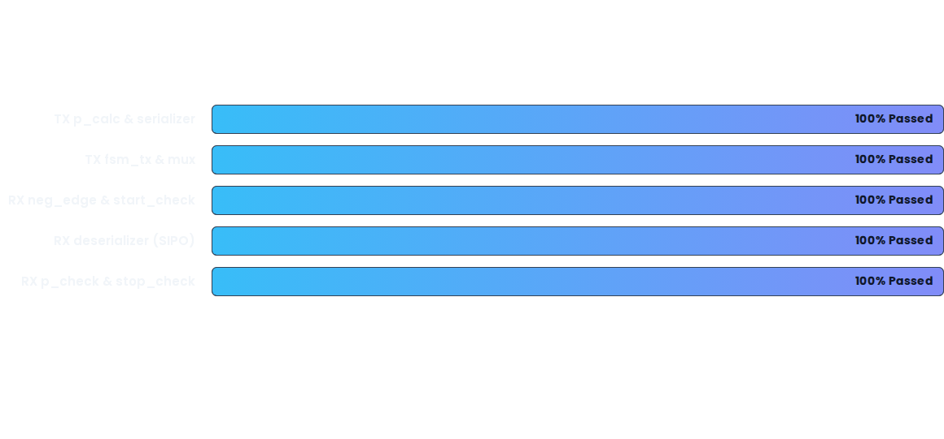
Verification Results & Pass Rates
Simulated in ModelSim / QuestaSim with zero syntax errors, zero timing warnings, and cycle-accurate waveform alignment.

Slide 13




Project Milestones & Roadmap
2. Unit Verification
4. Full Duplex Top
100% pass rate achieved across all standalone submodules.
Loopback integration and automated Grading Harness compliance.
1. Microarchitecture
3. FSM Integration
Modular specification of 4 TX and 6 RX blocks in SystemVerilog.
Submodule integration under fsm_tx and fsm_rx supervisors.

